Slide 1


IT Services Challenge: Improving IT Service Delivery to Federal Departments
For Shared Services Canada (SSC)

Slide 2
Content
01
02
03
04
Problem Statement
Findings of Data Analysis
The key challenges and objectives
Correlation analysis and causation
Recommendations
Future Expansion
Process improvement
More possibilities

Slide 3
01 Problem Statement
Challenge: Identify areas for process improvement that will enable SSC to improve on its ability to meet service target for incident management.
Objective: Propose solutions to decrease the number of incidents where the time to resolve the issue exceeds the target.

Slide 4
02
Findings of Data Analysis

Slide 5
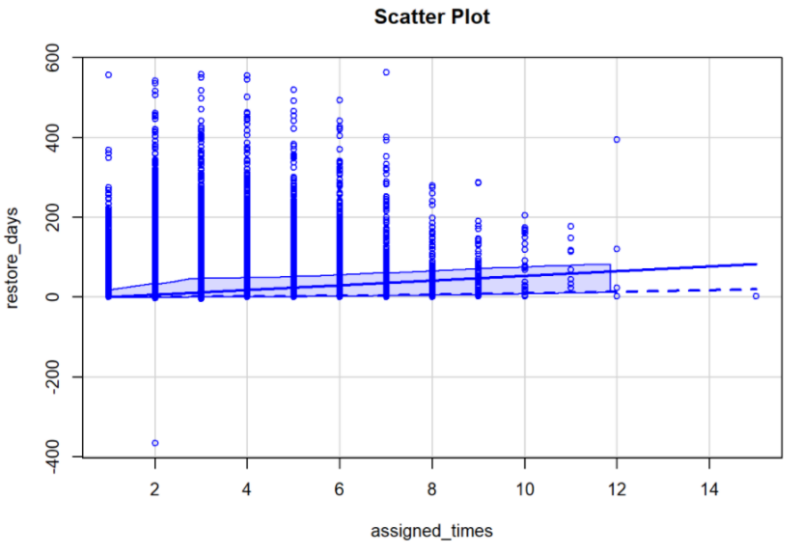
Correlation between Assigned Times and Restore Days

Slide 6
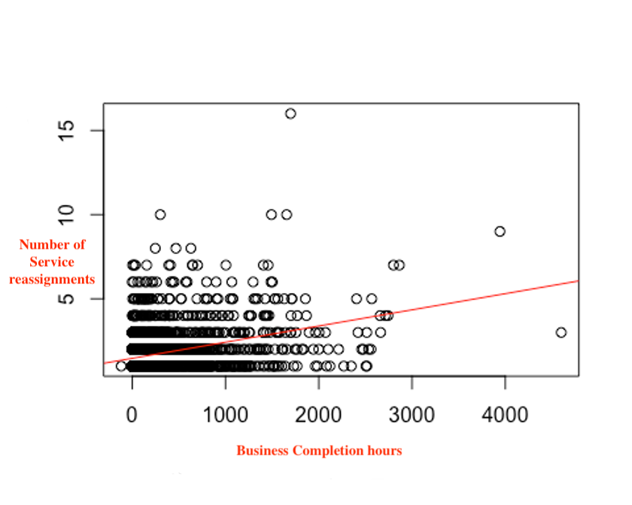
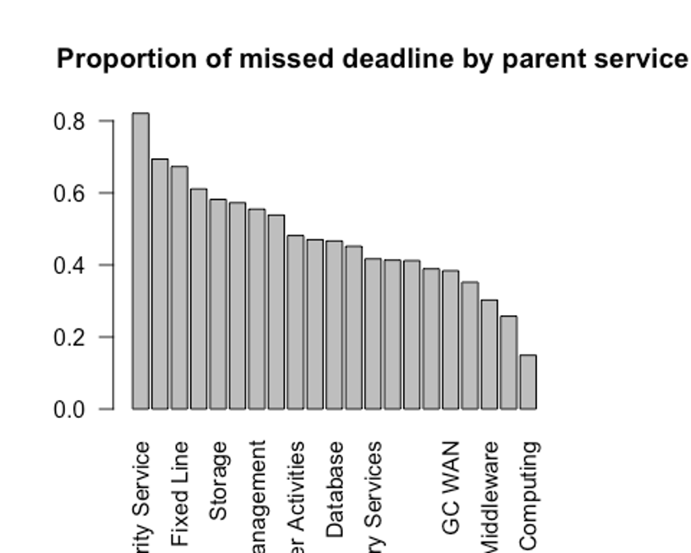
Which factors correlate with the number of missed targets?
Number of reassignments ?
Services ?
We also observed correlations between The proportion and missed targets and:
The organisations
The type of incident
The external system

Slide 7
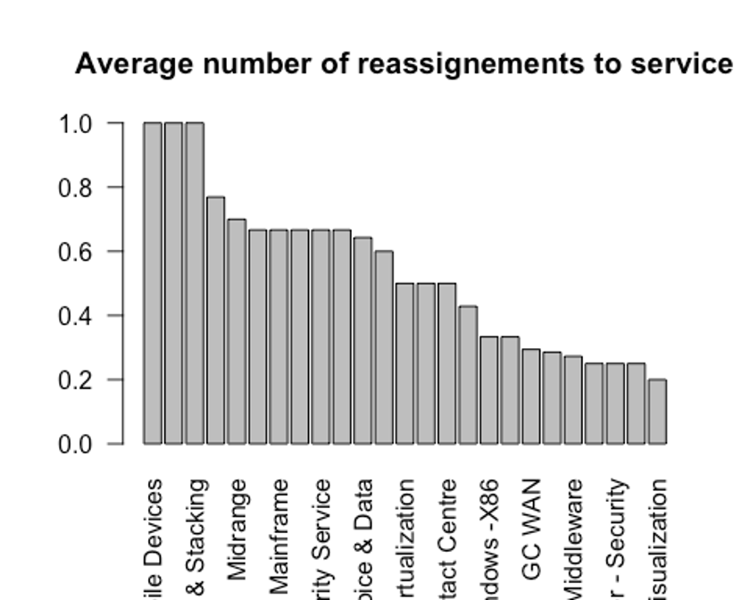
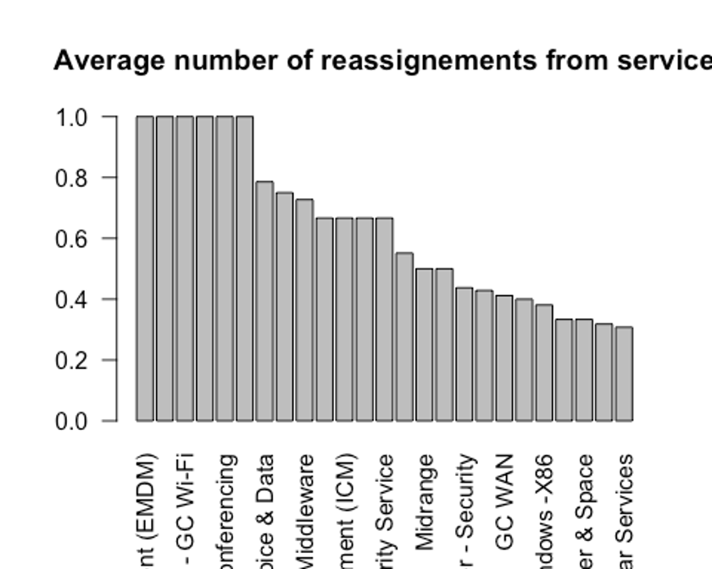
Particular services causing large resolving times?
We observed that some services receive a high number of reassignments, while others reassign a lot to other services.
Average = (Number of distinct ticket numbers reassigned to this service)/ (Total Number of distinct ticket numbers that went to this service)
For Services with high numbers, it could be due to services that collabore a lot with others but there’s also the possibility that the incidents are wrongly assigned

Slide 8
Top 5 Organizations by # of tickets
Organization | # of Tickets | Median # of days till actual completion
1342 | 75443 | 0.85
1047 | 32789 | 0.70
1062 | 27054 | 0.58
1028 | 12910 | 1.53
1045 | 7312 | 1.86

Slide 9
Top 5 Groups by # of tickets
Group | # of Tickets | Median # of days till actual completion
DC000203 | 13323 | 0.13
DC000152 | 11876 | 0.22
NW000417 | 9728 | 1.50
ESI00011 | 9711 | 3.02
NW000412 | 7603 | 5.89

Slide 10
Top 5 Service by # of tickets
Service | # of Tickets | Median # of days till actual completion
Midrange - Windows -X86 | 30689 | 0.49
GC WAN | 25757 | 1.10
Other - Service Management | 20724 | 0.80
Middleware | 15235 | 0.30
High-performance Computing | 13271 | 0.89

Slide 11
Top 5 Groups on Midrange - Windows - X86 Service
Group | # of Tickets | Median # of days till actual completion
DC000203 | 13323 | 0.13
DC000202 | 5032 | 0.83
DC000115 | 4624 | 1.95
DC000236 | 1948 | 0.79
DC000200 | 1290 | 1.70

Slide 12
Particular Services with Long MTRS
IT Continuity Support Service
Solutions Integration Service (SIS)
Medium Priority
Assigned Four Times
421.9 Business Completion days
Low Priority
Assigned Three Times
117.3 Business Completion days

Slide 13
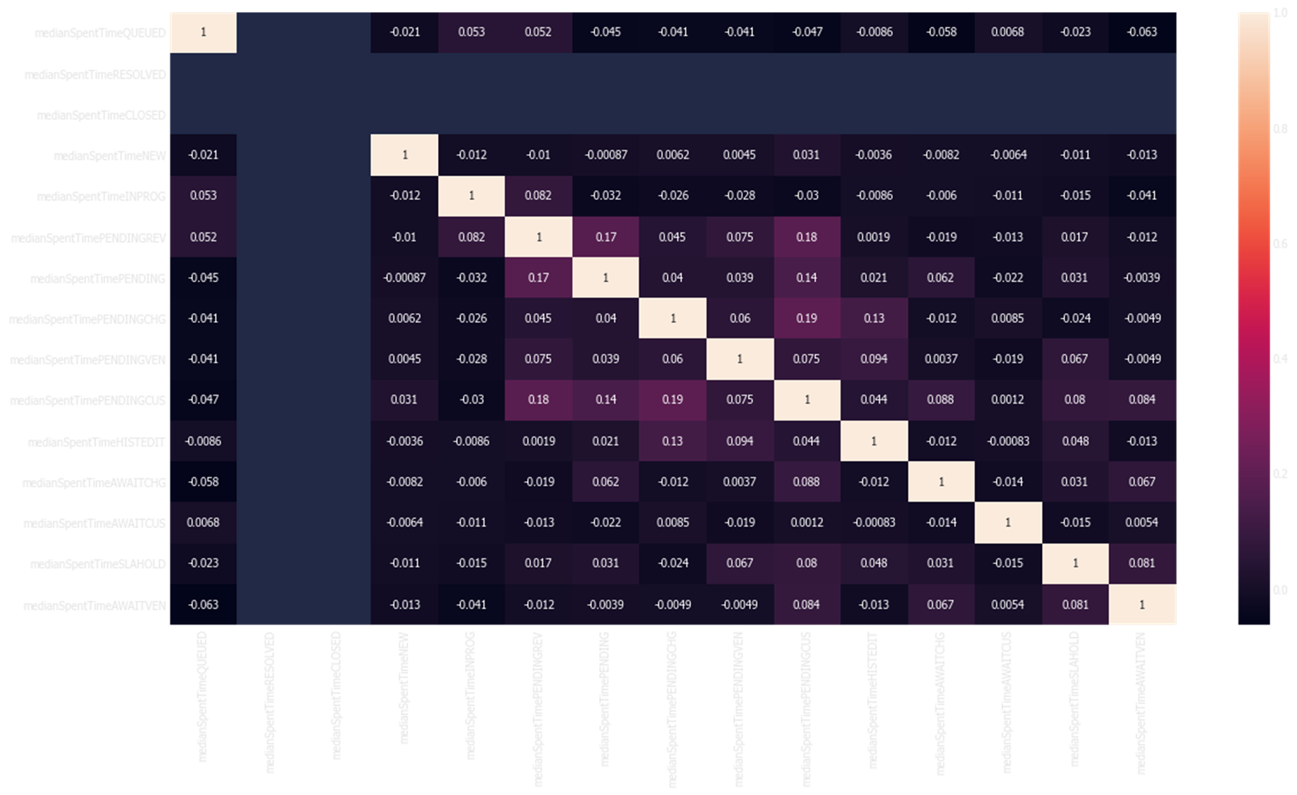
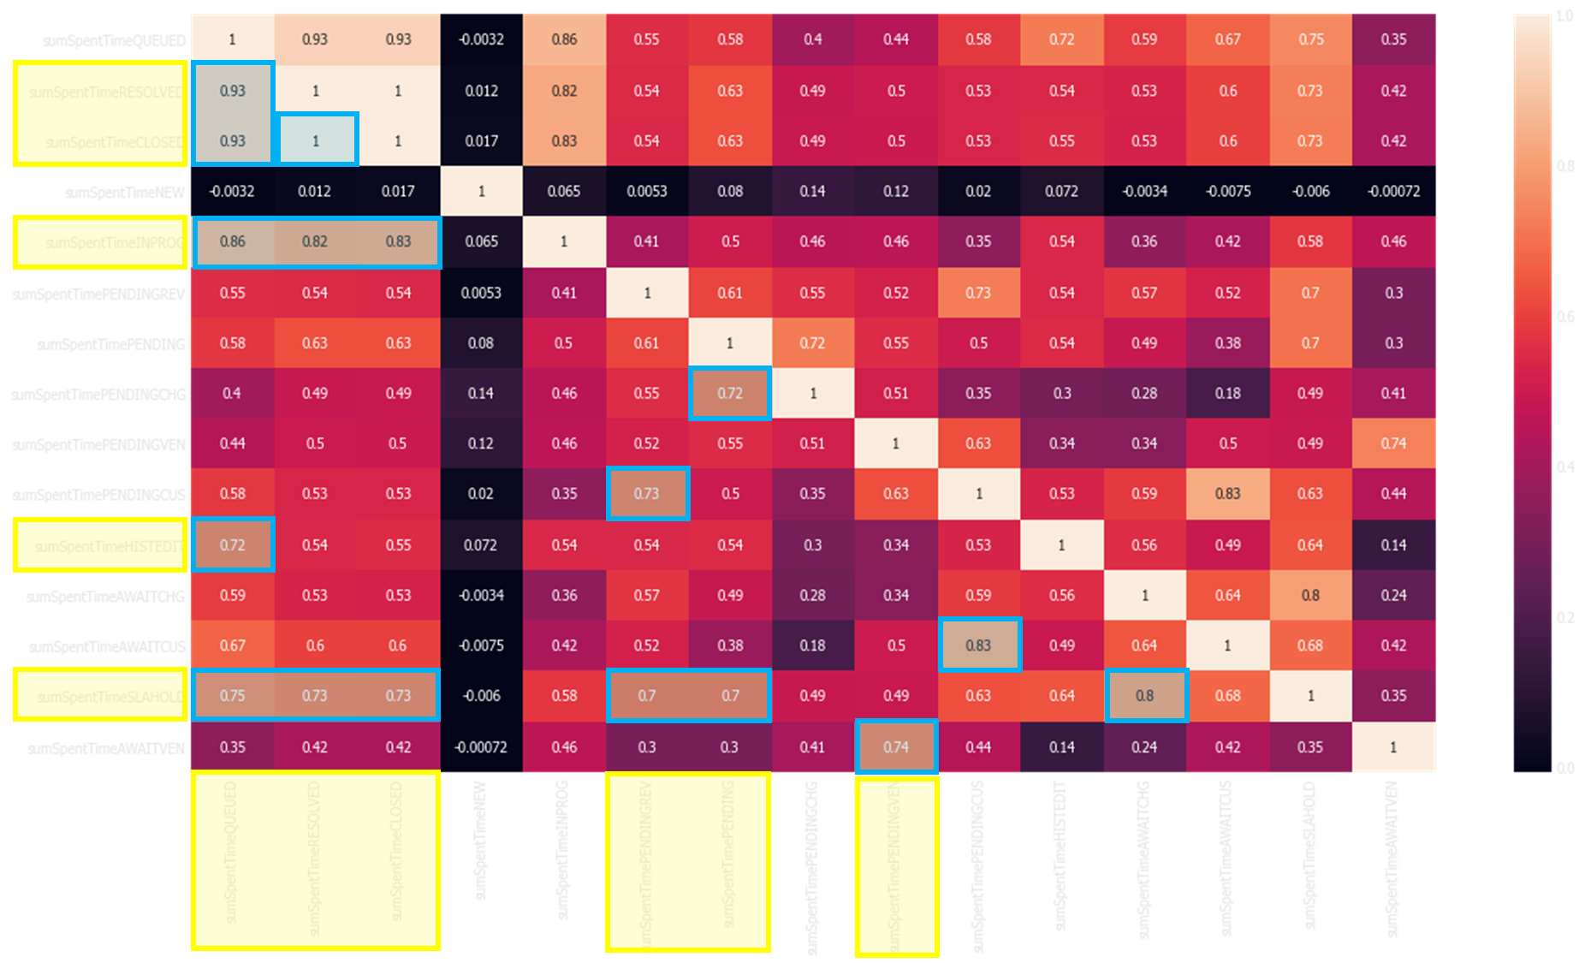
Correlation Analysis
By Parent Service:
The time spent in the AWITCHG and AWAITVEN status is correlated with SLAHOLD status.
The Total number of hours have be saved from SLAHOLD status is 12365h
Heatmap 1 & 2: Total Vs. Median Time Spent by Assigned Group
Notes:
s there a correlation to certain groups where tickets stay in a particular status that is resulting in longer times to restore service?
There are many Event Management tickets. What is the difference in incidents ticket including and excluding Event Management tickets?

Slide 14
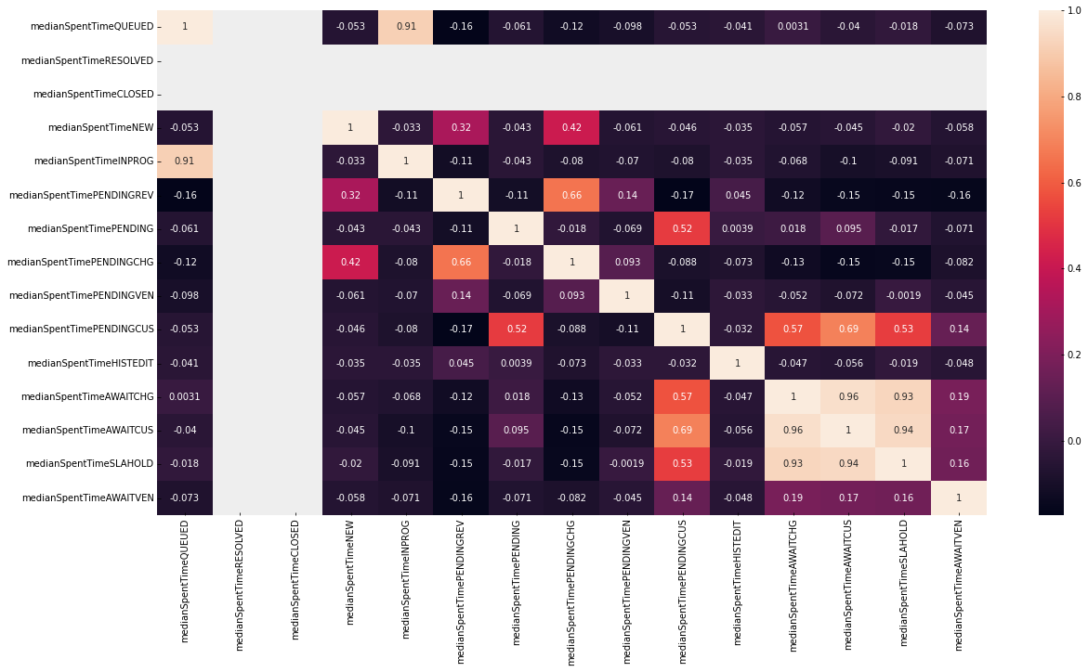
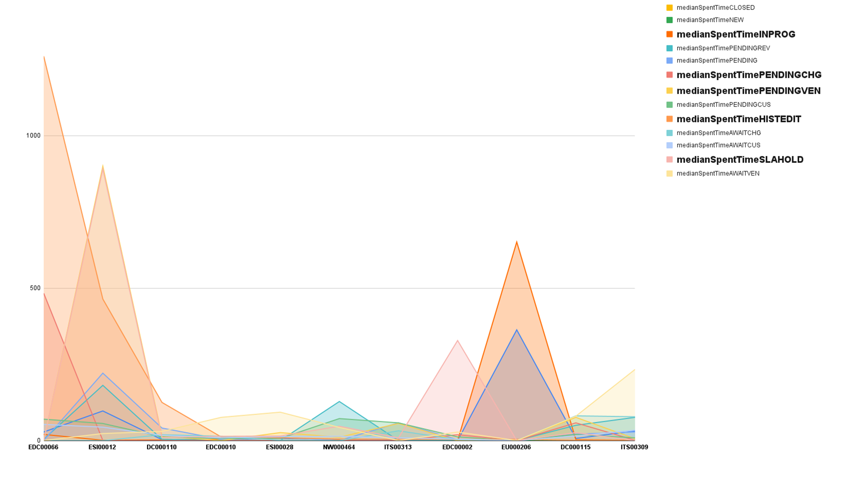
We calculate the mean of the time spent by each group in every status. then plot the correlation matrix. There are clear corrections between the time spend in each group at the level of status.
The event management tickets does not take much time in average and has not big impact on the timeline of a ticket life cycle.

Slide 15
03
Recommendations

Slide 16
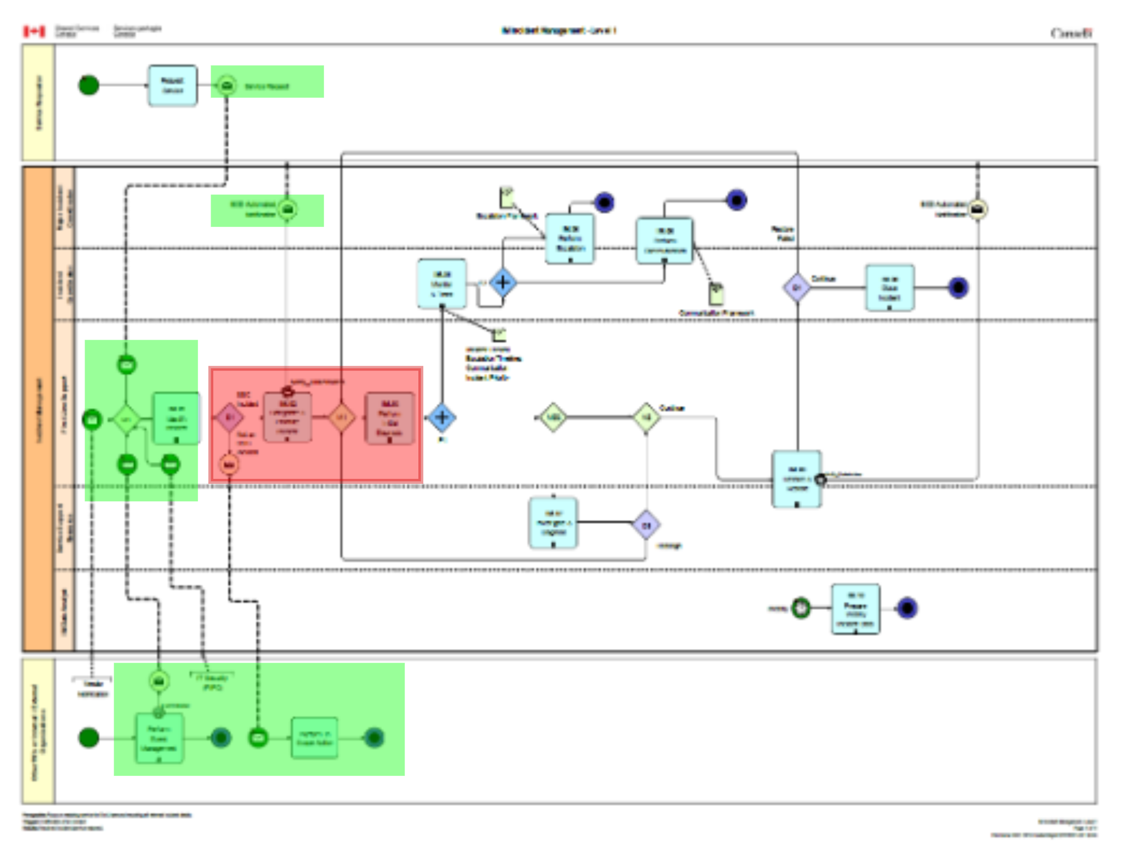
Problem.
The red block is causing the reassignment (wrong assigned group, multiple assigned group, …)
Solution.
The green blocks are the descriptions of the incidents given from different sources. We propose implementing a Machine Learning algorithm that helps the frontend classify tickets and assign them to the proper group. The model would be trained on the existing data SSC holds.

Slide 17
What we are suggesting…
Question List for Incident Definition
Information Processing Before Assigning
Task Prioritization
Process Monitor

Slide 18
04 Future Expansion
For services that receive a lot of reassignments look at what services they receive it from.
For services that reassign a lot, look what services they reassign to.
This could help detect where wrong assignments are coming from.

Slide 19
Thanks for Listening
Any Questions?

